Slide 1



Design of high density SiP
for complex computing system in micro SD format
Chris BARRATT
Insight SiP Sophia Antipolis FRANCE
FRANCE

Slide 2

Agenda
Introduction
Design Process
Functional Specification
Architecture
Component Choice
Size versus Component Choice
Detailed Schematic
Breadboard
Substrate Technology
Layout
Electromagnetic Simulation
Assembly
Test and Debug
Micro SD Linux Computer
“From Sketch to Product”

Slide 3
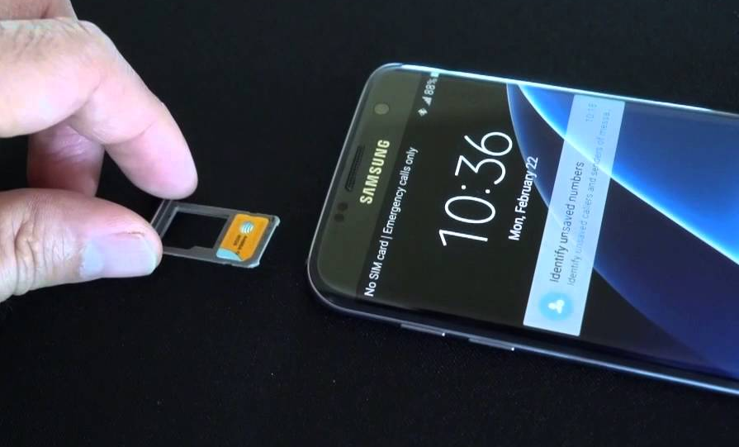
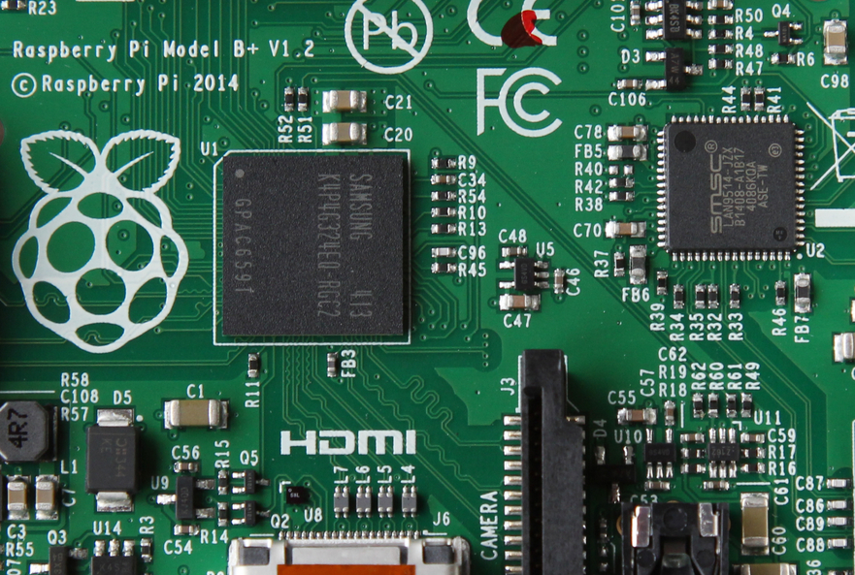
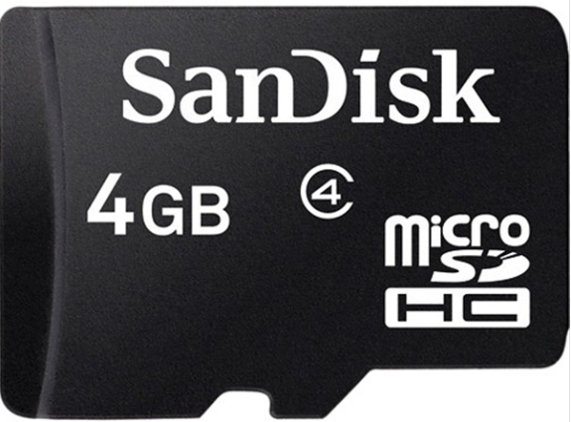
Introduction
The Challenge
How to fit a microprocessor and some memory
Inside a Smart Phone
Sorry How to fit a Linux Computer
Inside a Smart Phone

Slide 4
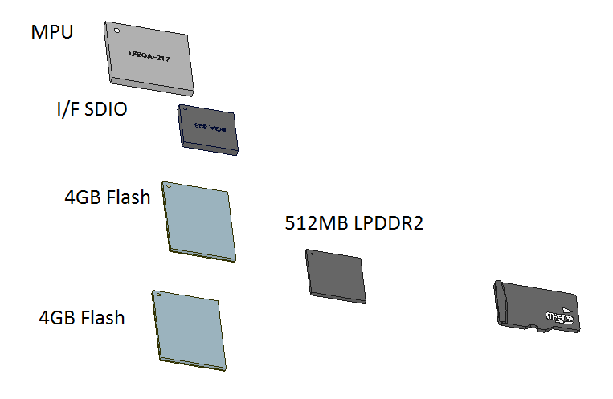
Functional Specification
Must Fit inside a Smart Phone
Must use micro SD slot
Size 11 x 15 x 1 mm
Interface to Phone via SD interface
Sufficient RAM to run Linux
Sufficient Storage to hold Linux image and programs
Operates from SD power supply
Time to Market
RAM 512MB
Flash 8 GB
MPU
Access via SD port
Runs off 3V from SD

Slide 5
Architecture
Architecture Choices
Meet Functional specifications
Choose off the shelf components (Time to Market)
Consider solutions which have Linux implementations
2.7V in
3.3V out
1.8V out
1.2V out

Slide 6






Component Choice
Criteria
Wafers or WLCSP must be available
NDA process essential
Negotiate with Chip Vendors on a project by project basis
Need to obtain wafer data early to make decisions
Die sizes must be compatible with Micro SD footprint
Must meet architecture requirements
Ideally need EVK with working software stacks for a “breadboard”
Thickness of WLCSP and SMTs must be compatible with Micro SD (< 0.5 mm)
MPU
SD Client
Memories
Flash
Controller
Power
Supply

Slide 7
Size vs Component Choice
Evaluate Assembly Options
For each Option estimate size
Choose best compromise
Solution adopted
4 die Wire Bond Memory stack
LPDDR2 + 2 NAND Flash
Flash Controller on LPDDR2
2 die WB stack MPU On FPGA
4 WLCSP power supply components
40 SMT Chips (01005, 0201,..)

Slide 8
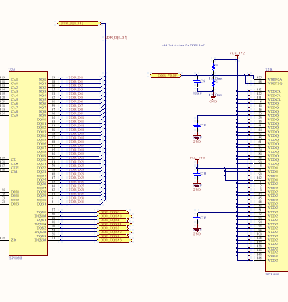
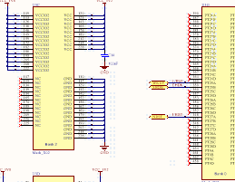
Detailed Schematic
Create a detailed schematic
2 versions are required
Breadboard with packaged components
SiP design with bare die components
Optimization of Power supply and decoupling is crucial to fit inside small footprint
Reduce number of passives from 80 to 40
Power supply components need to be very small

Slide 9
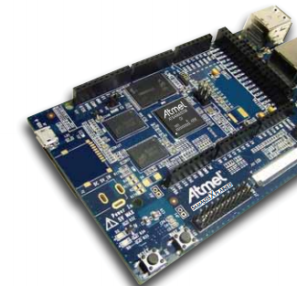

Breadboard
Same schematic as SiP
Uses Packaged components
Based on MPU EVK
Allows first level Hardware Debug
Allows Firmware Development to be essentially in parallel with SiP Hardware
Can be used in SiP debug as reference

Slide 10
Substrate Technology
Requirements
Wire-bond capable
100um wire bond finger pitch
Complex routing ➔ 6 layers
Fine line 30um / 30 um
Rear side contacts ➔ Hard gold
As thin as possible <=0.25mm
Lowest cost option
Solution
6 layer any layer to any layer
Electrolytic gold
Complex plating (buss bar ruled out)
using 9 process steps
Pushing limits for etched technology
Overall substrate very thin (0.22mm)

Slide 11
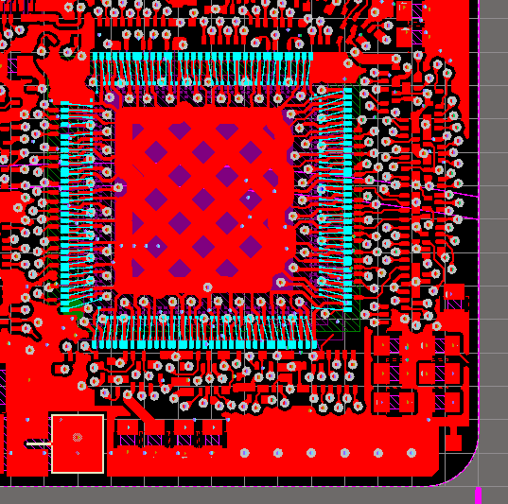
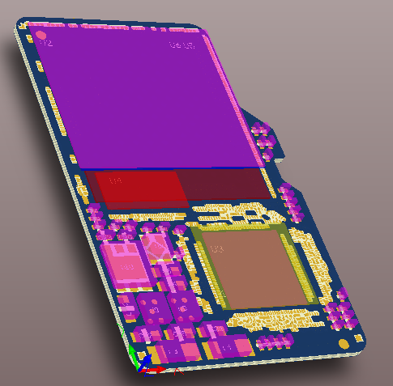
Module Layout
Schematic to Layout
Tool-sets
Cadence Allegro SIP
Mentor Graphics Xpedition Package Integrator
Keysight ADS
Altium PCB
Other PCB tools
Capability
COST
2D Routing
3D View

Slide 12
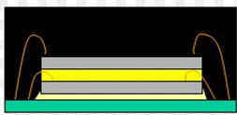
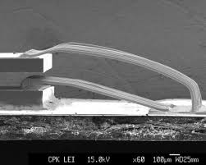
Module Technologies
Die Stacking
3 dies in < 0.58 mm height
Die thickness 60 – 80 um
Film on Wire
Low loop heights
Same die size stack
Wire-bonding
4 layers of wire bonding
Accurate x y z control to avoid shorts
Small actives
WLCSP <0.5mm
DFN < 0.4 mm
Passives
01005 mostly
0201 > 100nF
0402 > 2 uF
0603 low profile for DC:DC chokes

Slide 13
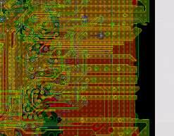
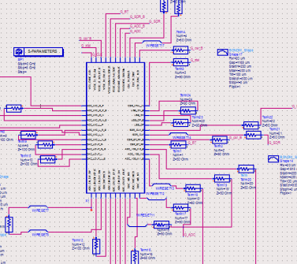
Electromagnetic Simulation
Toolset
Keysight ADS Momentum 2.5D / full 3D FEM
Ansys HFSS full 3D EM
Substrate Simulation
Multi-port s parameters (> 100 ports)
High speed track impedances
Coupling between power supply and high speed signals
Effectiveness of decoupling methods (mix EM/Schematic models)
Iterative process
Avoids major failures at first prototype phase
Can be used to fine tune second spin (if needed)
2.5D simulation of Layout
Evaluation of Effects in Schematic

Slide 14

SiP Assembly
Courtesy of Amkor
SMT placement and reflow
Sequential Die attach – Wire bond
Accurate 3D wire control
Over-molding
Requires DOE to setup process
Electrical Prototype yield > 95%

Slide 15
Debug Process
Assumes Breadboard is fully functional
Using Test Board and Socket
Power Up and Validate Power supplies
Program MPU with boot sequence and Linux Kernel via JTAG
Program FPGA with code
Initialize Flash Controller via MPU
Boot from Flash
At each step issues can arise
Compare output with breadboard
Attempt to put breadboard into same failure mode as SiP
Attempt to change SMTs in SiP (accurate diamond drilling)
Example
Issues with assembly spins 1 & 2 was linked to an un-calibrated die and component labelling!!!
Spin 3 using same substrate is fully functional

Slide 16
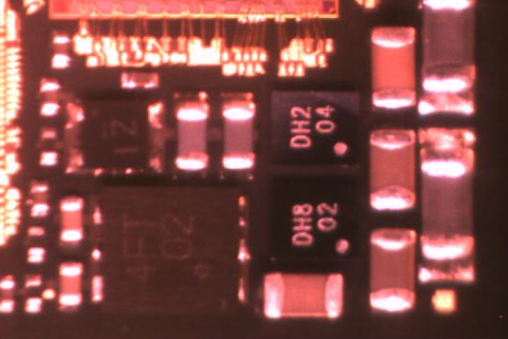
Micro SD Power Supplies
2 Step down power supplies
1.2V, 1.8V
1 step up power supply
3.3V from 2.7V
1 power supply monitor
Detect under voltage

Slide 17
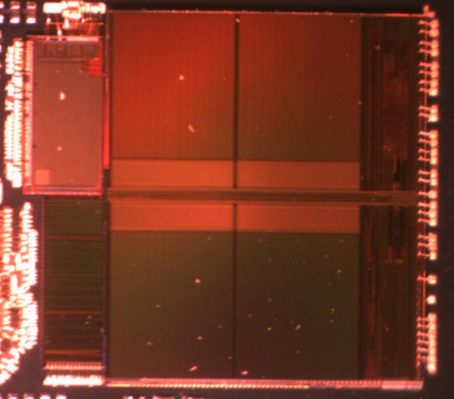
Memory Stacking
LPDDR2
Wirebonds N&S
Flash controller
Wirebonds W
Nand Flash
Wirebonds E
Total Thickness < 0.5mm
Total 250 wirebonds
Flash Ctrl
Nand x 2
LPDDR2
Flash Ctrl
Nand x 2
LPDDR2

Slide 18
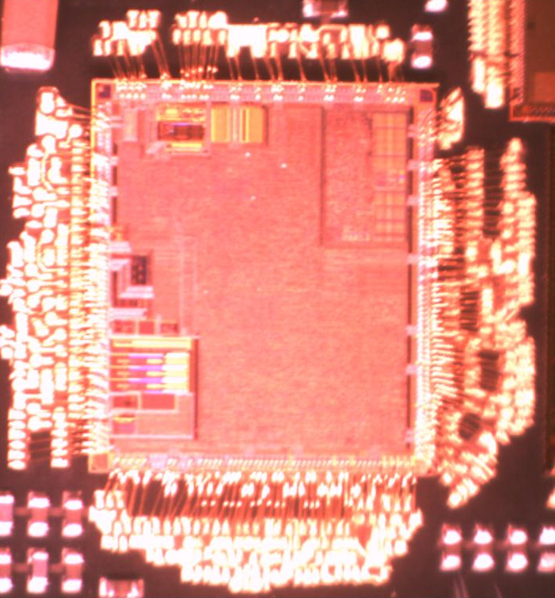
MPU on FPGA
FPGA
Wire-bonds on 2 rows on 4 sides
Die is smaller than MPU
FPGA is under MPU
191 Wire-bonds
MPU
Wire-bonds on 2 rows on 4 sides
Die is bigger than FPGA
MPU is on top
314 Wire-bonds
MPU
FPGA

Slide 19
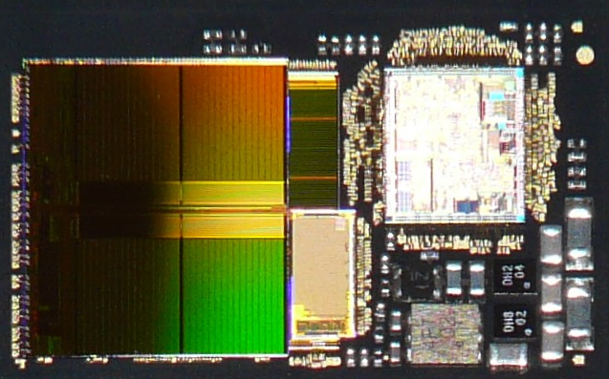
Linux on a Micro SD

Slide 20
Conclusions
Design Process for Complex SiP has been demonstrated
Uses State of the Art « Mainstream » technologies
Avoids the use of expensive tool-sets
Avoids the use of unproven technologies
Heterogeneous SiP for medium volume requires a conservative approach
The Example micro SD SiP is probably smallest Linux computer today

Slide 21


Thank you

